Slide 1
I just finished one of the most popular Python courses online, and honestly, would
struggle to recommend it
Hi there, I am Elliot and I am completing and ranking every single beginners python
course on the internet
I think Codecademy has almost been a victim of their own success here, I was expecting so much more but I came away relatively disappointed actually. In this video I’ll be covering the following, and these will all be timestamped in the description below. Lets get into it:
What is it – It’s a freemium one stop shop for basically upskilling in any language
My ranking – and the reasons why (Python 2! Restrictive editor, complete randomness of lessons, no real big picture/context for the lessons)
The best bit & je ne seis quoi – I’d be forcing it if I said there was anything standout great about this course
The redemption arc – Could it be for you? I’ve given them no credit for all the extras, but I’m not doing a website ranking list, I’m doing a python ranking list. I have a feeling this is for businesses with training budget. Because it’s so comprehensive it’s a great platform for a student or employee to learn, and have progress tracked and clearly show it to a manager or whatever.

Slide 2

Introduction to python course review

Slide 3
Introduction to python course review

Slide 4
Today
WHAT IS IT?
SCORING (AND WHY)
THE BEST BIT™️
FINAL SCORE
IS IT FOR YOU?
MY ADVICE IF I WAS STARTING OVER

Slide 5
Placeholder browse the website (what is it)

Slide 6
Scoring and why
 | LearnPython.org | Sololearn | Codecademy | Average
Context & Relevance | 2 | 3 | 3 | 2.7
Course Structure | 5 | 7 | 4 | 5.3
Content Quality | 9 | 4 | 5 | 6.0
Flow & Interactivity | 6 | 4 | 4 | 4.7
Pacing | 6 | 7 | 6 | 6.3
Production & Medium | 5 | 7 | 5 | 5.7
Value | 8 | 5 | 5 | 6.0
Je ne sais quoi | 2 | 1 | 0 | 1.0
Total | 43 | 38 | 32 | 37.7

Slide 7
Scoring criteria
Criteria
Measure
Context & Relevance
Course Structure
Content Quality
Flow & Interactivity
Pacing
Production Medium
Value
Is it clear why you’re learning each topic?
Are real‑world use cases or analogies provided?
Is the curriculum ordered logically (prereqs before advanced topics)?
Are topics grouped clearly rather than scattered?
Is enough covered? Do exercises and examples reinforce core concepts?
Are the explanations accurate, clear, and free of errors?
Do quizzes/tutorials match what was just taught?
Is there enough practice to cement learning before moving on?
Does energy stay consistent across the full runtime?
Is the speed appropriate, never too slow (boring) or too fast (overwhelming)?
Is the UI smooth, intuitive to navigate?
Is any audio/video on screen detracting or badly edited?
Does it feel “premium” enough that you wouldn’t mind paying?
Is it worth the price?

Slide 8
Why the Course structure wasn’t great
WHAT IS IT?
SCORING (AND WHY)
THE BEST BIT™️
FINAL SCORE
IS IT FOR YOU?
MY ADVICE IF I WAS STARTING OVER

Slide 9
Placeholder to show excel (why the structure wasn’t great)

Slide 10
The best bit
WHAT IS IT?
SCORING (AND WHY)
THE BEST BIT™️
FINAL SCORE
IS IT FOR YOU?
MY ADVICE IF I WAS STARTING OVER

Slide 11
Placeholder The best bits 4.15 – reps on reps timed breakdown Freemium done well

Slide 12
Final score
 | LearnPython.org | Sololearn | Codecademy | Average
Context & Relevance | 2 | 3 | 3 | 2.7
Course Structure | 5 | 7 | 4 | 5.3
Content Quality | 9 | 4 | 5 | 6.0
Flow & Interactivity | 6 | 4 | 4 | 4.7
Pacing | 6 | 7 | 6 | 6.3
Production & Medium | 5 | 7 | 5 | 5.7
Value | 8 | 5 | 5 | 6.0
Je ne sais quoi | 2 | 1 | 0 | 1.0
Total | 43 | 38 | 32 | 37.7

Slide 13
Final score
 | LearnPython.org | Sololearn | Codecademy | Average
Context & Relevance | 2 | 3 | 3 | 2.7
Course Structure | 5 | 7 | 4 | 5.3
Content Quality | 9 | 4 | 5 | 6.0
Flow & Interactivity | 6 | 4 | 4 | 4.7
Pacing | 6 | 7 | 6 | 6.3
Production & Medium | 5 | 7 | 5 | 5.7
Value | 8 | 5 | 5 | 6.0
Je ne sais quoi | 2 | 1 | 0 | 1.0
Total | 43 | 38 | 32 | 37.7

Slide 14






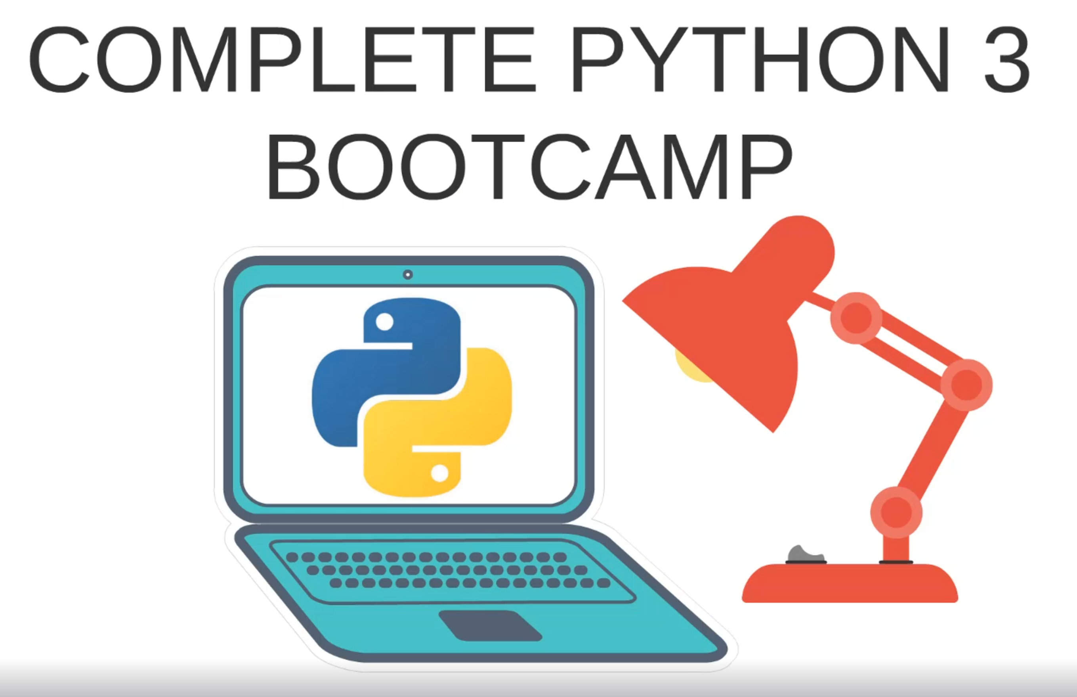
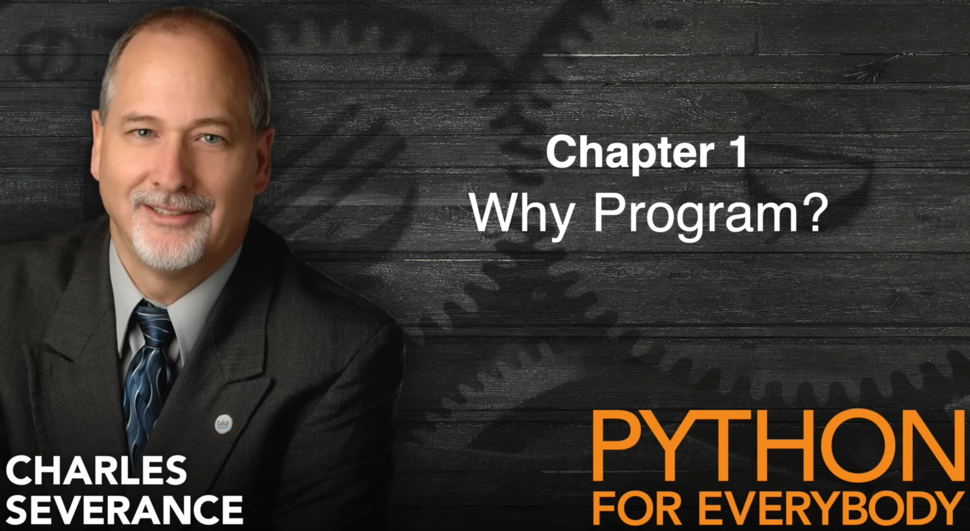




S
A
Learnpython.org
B
C
D

Slide 15
Is it for you?

Slide 16
Placeholder browsing all the niche features of the site

Slide 17
If I was starting over
WHAT IS IT?
SCORING (AND WHY)
THE BEST BIT™️
FINAL SCORE
IS IT FOR YOU?
MY ADVICE IF I WAS STARTING OVER

Slide 18
Return to slide 14 - rankings

Slide 19
browse learn python . org

Slide 20
Thank you
WHAT IS IT?
SCORING (AND WHY)
THE BEST BIT™️
FINAL SCORE
IS IT FOR YOU?
MY ADVICE IF I WAS STARTING OVER

Slide 21
THANK YOU
Introduction to python course review
Elliot Cooke

